Slide 1


Omnis on FHIR® ODC 2024

Slide 2
Pre-Requisites for Code Along
Docker Desktop
https://www.docker.com/products/docker-desktop/
Image
docker pull hapiproject/hapi:latest
Github
https://github.com/advancedconcepts/Omnis-FHIR

Slide 3
About Me
Stefan Csomor csomor@advanced.ch
Using Omnis since 1986
Medical Doctor & Ba CS
Snomed & FHIR

Slide 4
Agenda
Short Introduction to FHIR
Omnis Code with Examples
Code / Demo
Q&A

Slide 5

Short Introduction to
https://www.hl7.org/fhir

Slide 6
History – Data Push / HL7 Messages

Slide 7
State of the Art
Cloud based
Query driven
Open API
JSON (+XML)
HTTP/REST

Slide 8
FHIR®
Fast
Low Barrier of Entry / Implementors in mind
Healthcare
Domain
Interoperability
Not Modelling but Interchange
Resources
Building blocks

Slide 9
FHIR Versions
Mar 26, 2023 | Release 5 (Trial use - see below for discussion)
May 28, 2022 | Release 4B: Staging release of modifications in specific areas
Dec 27, 2018 | Release 4 (1st Normative Content + Trial Use Developments)
Feb 21, 2017 | Release 3 (STU - Standard for Trial Use)
Oct 24, 2015 | DSTU2 (Second Draft Standard for Trial Use)
Sept 30, 2014 | DSTU1 (First Draft Standard for Trial Use)

Slide 10
FHIR Manifesto
For Implementors
80/20 % Rule
Established Web-based Technologies
Human Readable (JSON at least ;-)
Strong Community

Slide 11
Exchange
REST most widely used
But other possible
FHIR data the same
REST
Operations
Messaging
Storage
Everything else

Slide 12
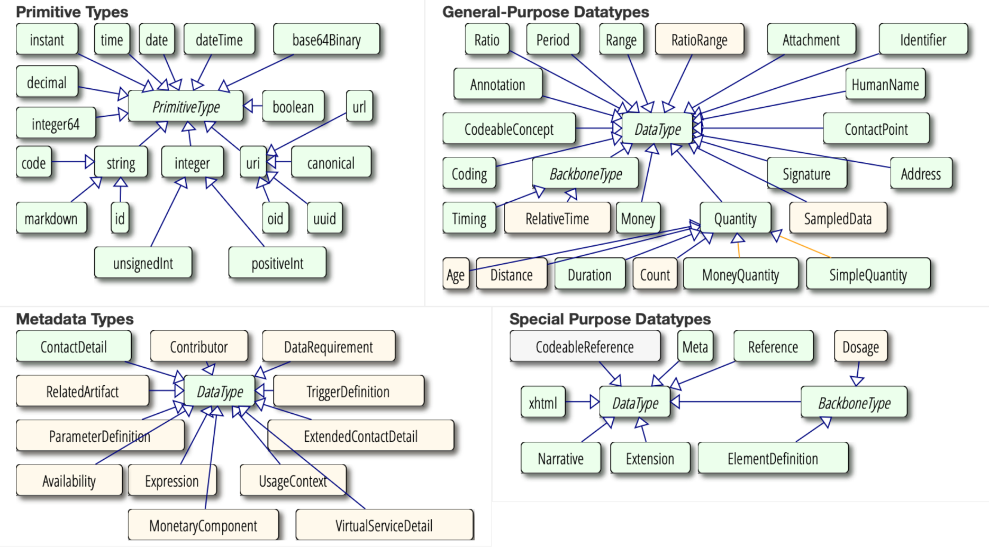
Lego Bricks for building Resources
Simple/Primitive
Single Value
Lower Case
Datatypes
Composed

Slide 13
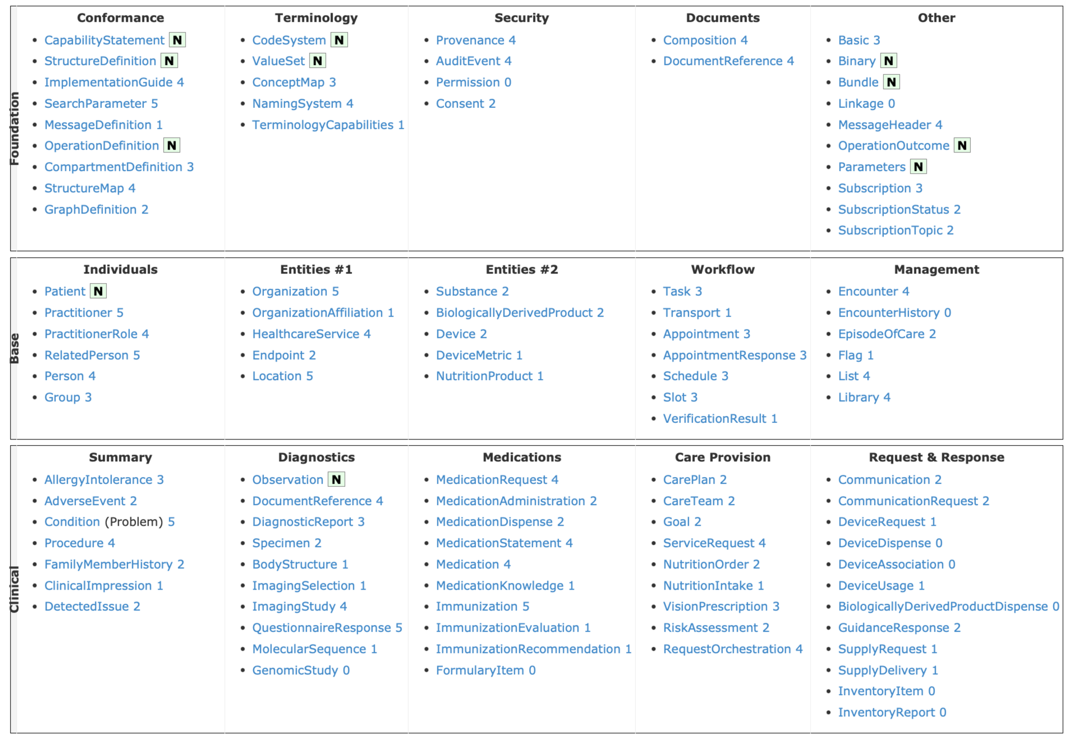
Resources http://hl7.org/fhir/resourcelist.html

Slide 14
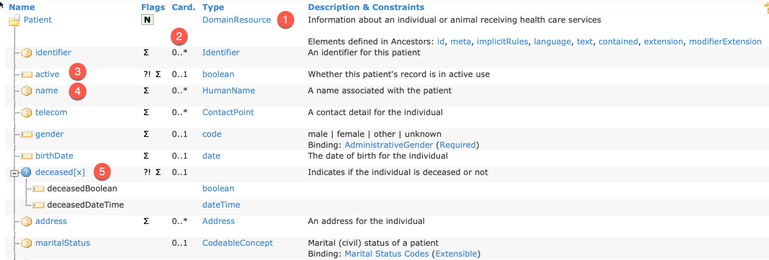
Resource Descriptions eg https://hl7.org/fhir/patient.html

Slide 15
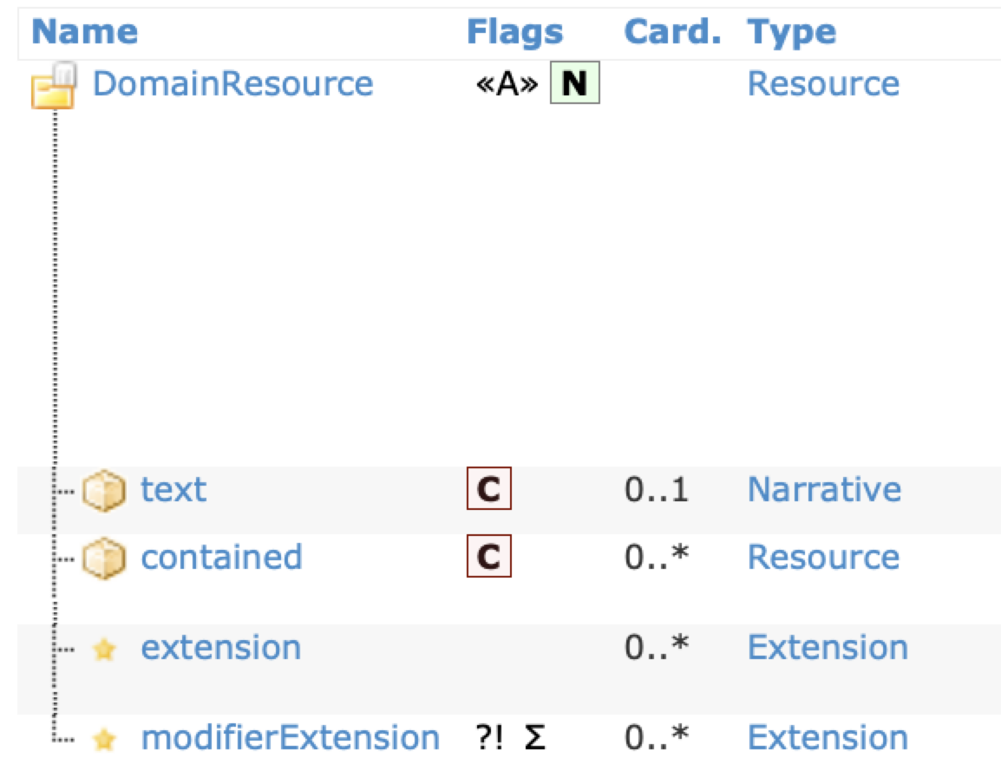
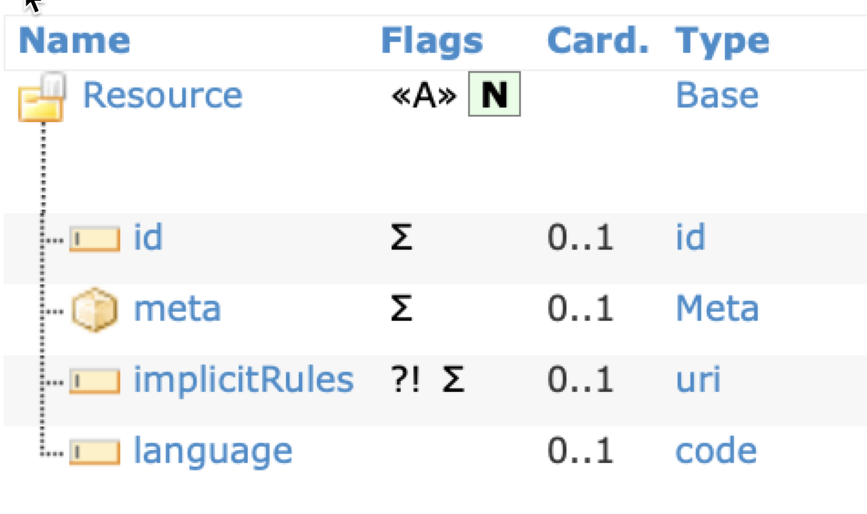
Inheritance

Slide 16
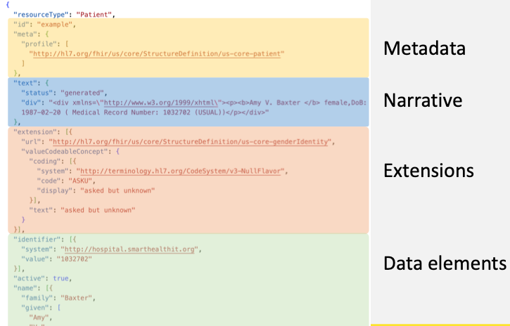

Slide 17
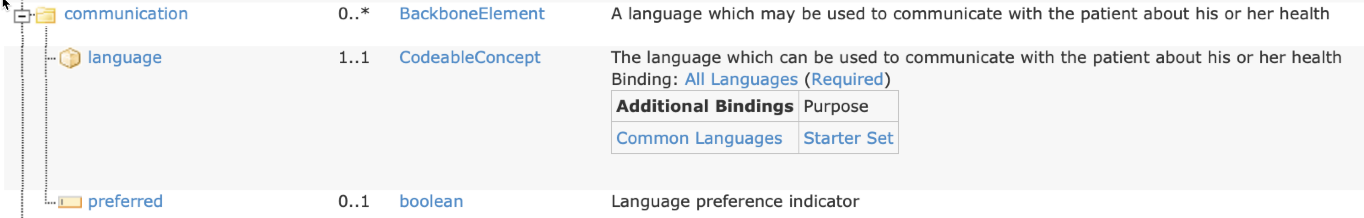
Cardinality
0 .. * → Collections
1 .. 1 → mandatory
0 .. 1 → optional
But additional constraints in the description

Slide 18
Elements
Simple Types (lowercase, field symbol)
?! = modifier attributes (important for meaning, cannot be ignored)
Σ = part of summary
Datatypes

Slide 19
Partial Dates
date and datetime simple types can contain some partial date formats
Only year
YYYY
Only year and month
YYYY-MM
Other variants (eg unknown year and unknown month but known day) only via extensions
the types instant and time do not have such partial values allowed

Slide 20
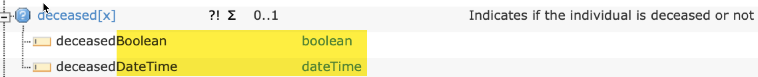
Polymorphic Elements
element can hold different types
elementname[x] : [x] replaced by concrete type
both in XML, as in JSON

Slide 21
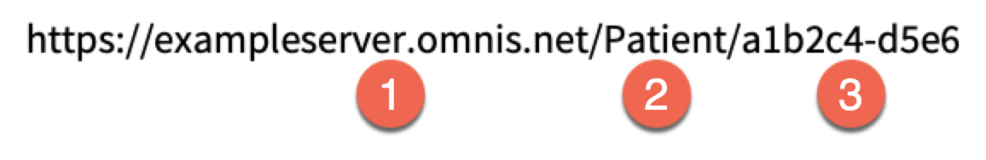
Resource Identity
Within the Resource Type: id
Complete URI
endpoint resource type [logical] id
Other Identifiers …

Slide 22
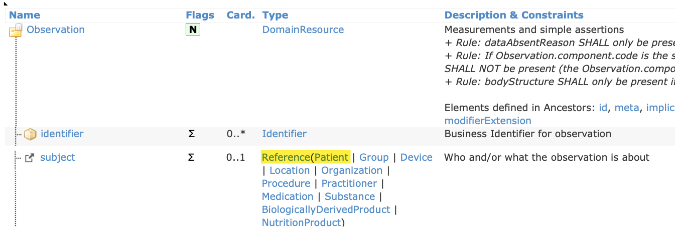
Linking Resources / References

Slide 23
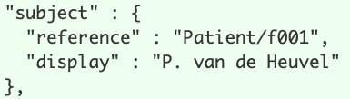
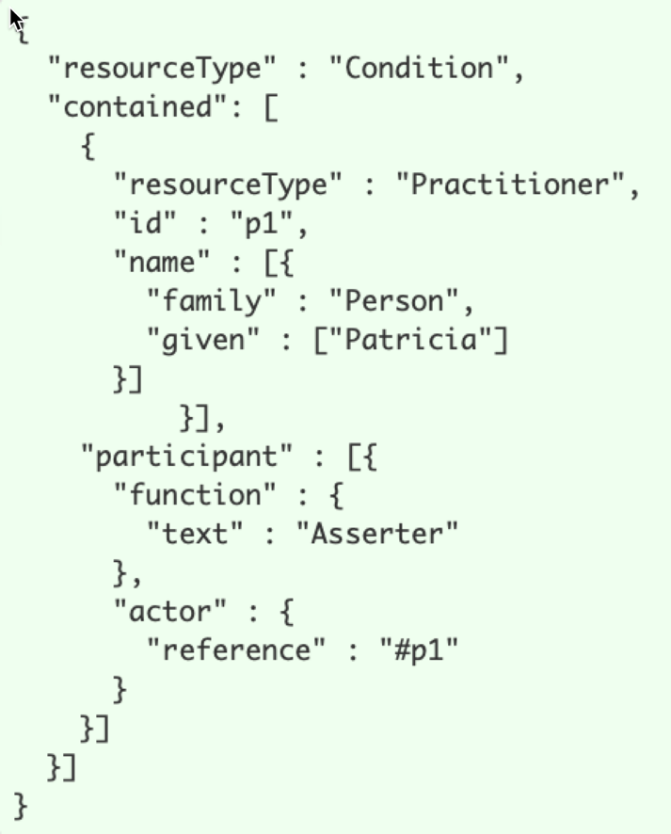
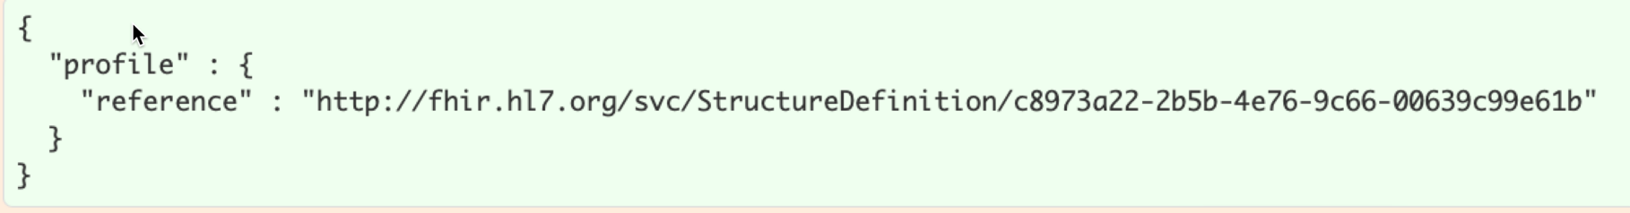
Literal References (via URLs)
Relative URL (Service Base URL) Internal Fragment Ref (contained Resource)
Absolute URL

Slide 24
Extensions
For the 20% not reflected in the Resource Description
Small extra bits of data
Useful or necessary in your country / your project / use case
{ "resourceType" : "Patient", "id" : "FranzMuster", "extension" : [{ "url" : "http://hl7.org/fhir/StructureDefinition/patient-birthPlace", "valueAddress" : { "city" : "Paris", "country" : "Frankreich" } }, { "url" : "http://fhir.ch/ig/ch-core/StructureDefinition/ch-core-patient-ech-11-placeoforigin", "valueAddress" : { "city" : "Köniz", "state" : "BE" } },

Slide 25
Profiles and Implementation Guides
FHIR Resource/Datatype + Extensions + Constraints
= Profile
{ "resourceType" : "Patient", "id" : "FranzMuster", "meta" : { "profile" : ["http://fhir.ch/ig/ch-core/StructureDefinition/ch-core-patient"] },
Implementation Guide
Describe how to use in a particular data exchange / how to get it right

Slide 26
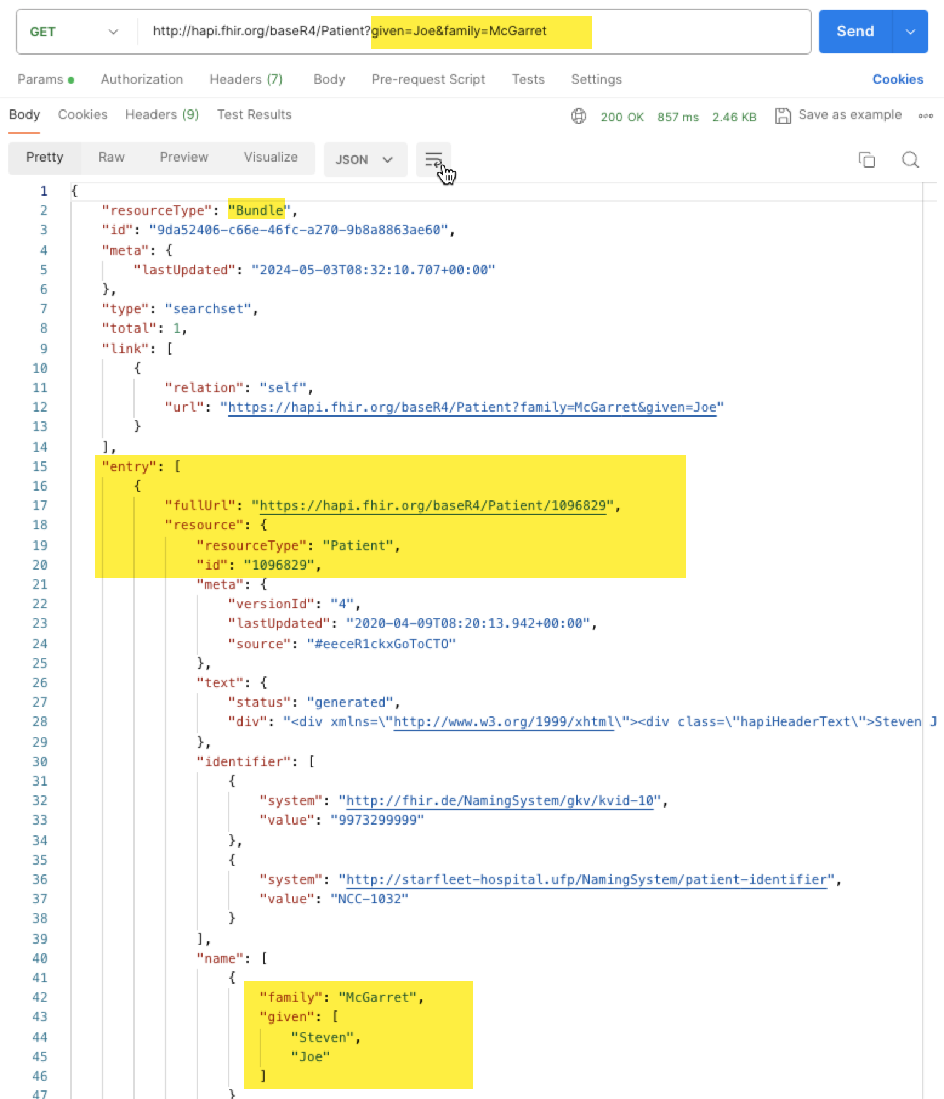
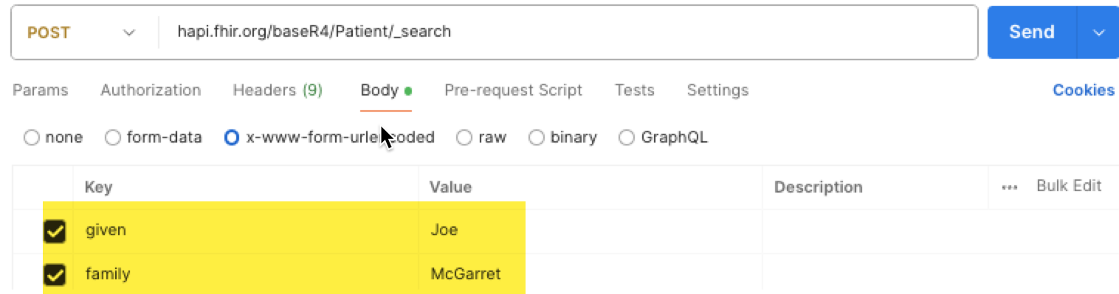
Searching
REST Standard GET with Query or POST with Params
Privacy Issues with GET in Logs

Slide 27
Security
Authentication
for Web oAuth2
Authorization/Access Control with Security Labels
Audit Log
Extensive Details at https://www.hl7.org/fhir/security.html

Slide 28
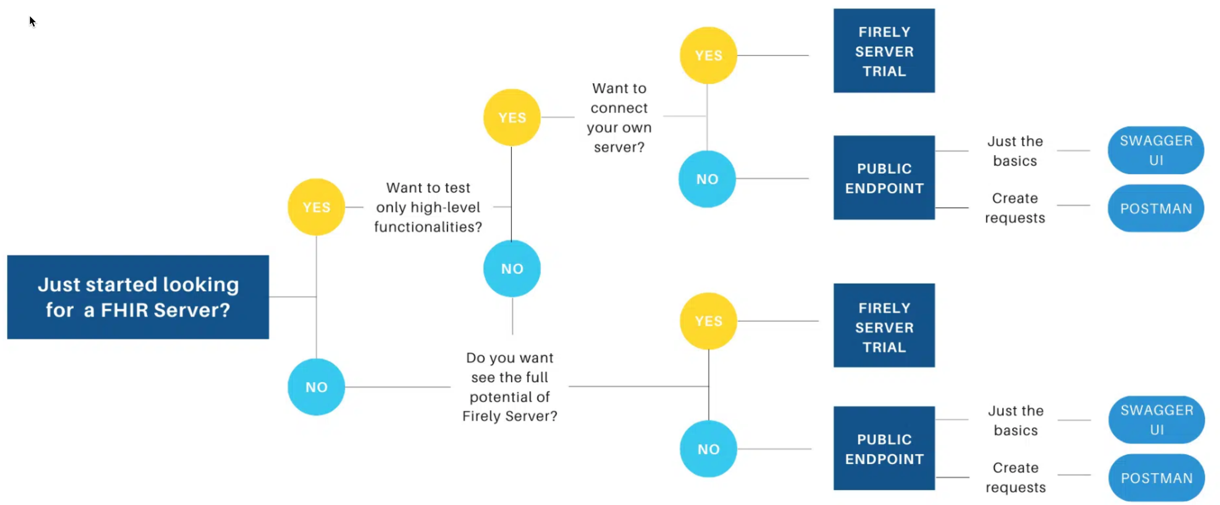
Test Servers: Public or Local

Slide 29
Public
List at https://confluence.hl7.org/display/FHIR/Public+Test+Servers
Select by needed features, eg Authentication through Smart on FHIR
https://server.fire.ly/r4 (/r5 etc ...)
http://hapi.fhir.org (Web UI)

Slide 30
Local
https://github.com/hapifhir/hapi-fhir-jpaserver-starter
https://hub.docker.com/r/hapiproject/hapi
docker pull hapiproject/hapi:latest docker run -p 8080:8080 hapiproject/hapi:latest
http://localhost:8080 (right now at version 4.0.1)
https://github.com/ahdis/matchbox
sophisticated testing infrastructure for profiles based on HAPI

Slide 31
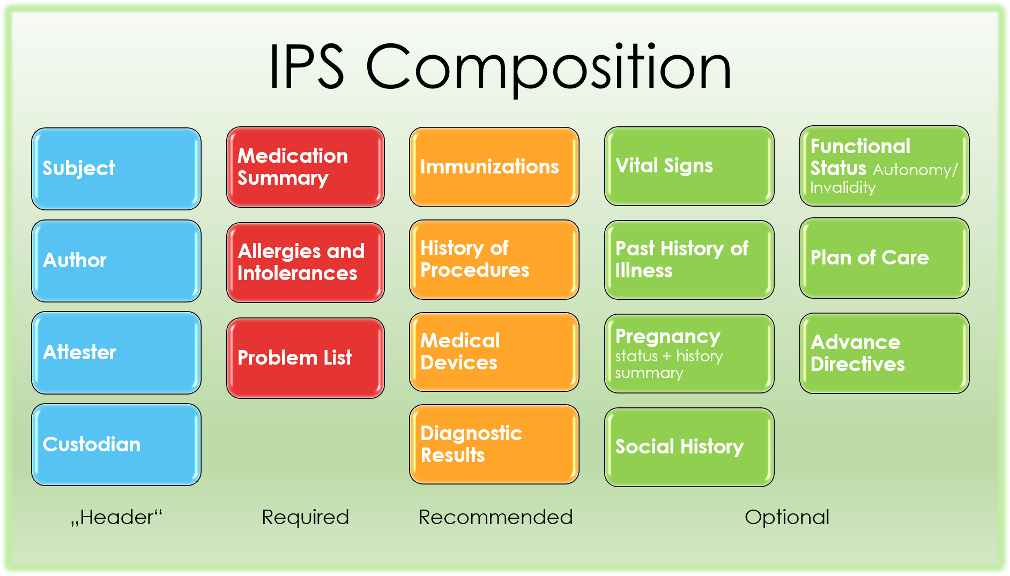
International Patient Summary
https://hl7.org/fhir/uv/ips/

Slide 32
Omnis on FHIR®

Slide 33
Real World Usage
Until 2020 First only personal interest
https://github.com/advancedconcepts/Omnis-FHIR
2021 Swiss Covid-19 Vaccination Portal offers FHIR API
(although incorrectly handling addresses!)
Since 2023 connecting own Practice Information System to Electronic Patient Record Domains using FHIR

Slide 34
Supporting Classes in fhir.lbs
oFHIRContext (Holding concrete FHIR Version, convenience methods)
oFHIRClientEndpoint (REST Client)
oFHIRBridge (Translation ‚native‘ ↔ FHIR representation)
oFHIRServerEndpoint (REST Server) not within scope of this presentation

Slide 35
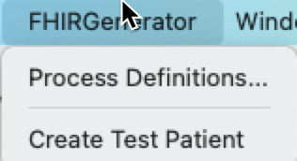
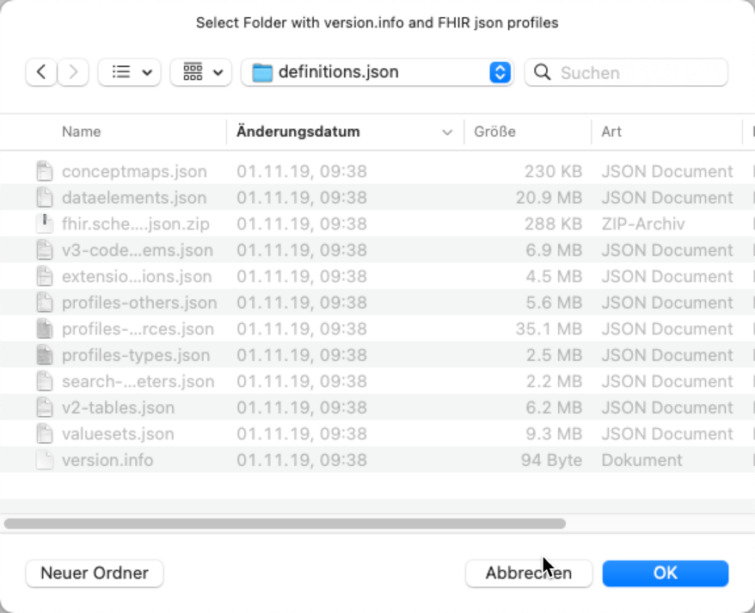
Generated Code for FHIR Types
fhir_tools.lbs generates one fhir_xx.lbs from JSON FHIR Definition files of each release
Pre-Generated for STU3, R4, R5
Includes ‚native‘ Documentation
Rebuild needed only for future versions or when handling is modified

Slide 36
Omnis FHIR Type System
Many Simple/primitive Types
As elements mapped onto native Omnis Types
FHIR Type | Omnis Type
instant, time | kDate / kTime
date, datetime (partial dates) | kCharacter, $assign “polymorph“
base64binary | kBinary
integer, unsignedInt, positiveInt | kInteger/k32bitint
Integer64 | kInteger/k64bitint
decimal | kNumber/kFloatdp
uri, oid, uuid, canonical, code, markdown, xhtml, id | kCharacter

Slide 37
Omnis FHIR Type System (cont)
Modelled after FHIR Standard -> oFHIRBaseElement in FHIR.LBS
For all (including simple types as objects):
FHIR Name kept (including casing), prefixed with ‚o‘
Patient -> oPatient, boolean -> oboolean
Object References used throughout
Indicate Type using a fixed version in Omnis IDE for autocomplete
For CodeSystems code classes prefixed with ‚cs‘ are used
Do code method csGenderIdentity/$male …

Slide 38
oFHIRContext
Challenge: Handling different FHIR Versions (fhir_xxx.lbs)
Version depends on the target system(s)
Multiple version at work at runtime
Indirection through instances oFHIRContext
Using Version String or version number as constructor argument
Convenience Methods for Resource Creation

Slide 39
Code / Demo

Slide 40
Open fhir_sample_client.lbs
Open oSampleClientEndpoint.$createPatientOnServer1

Slide 41
Set up FHIR Context
In $createPatientOnServer1
Set up FHIR Context (base class methods) eg. to „r4“
Calculate $cinst.$context as 'r4'
Verify context
If $cinst.$context().$isvalid()
End If

Slide 42
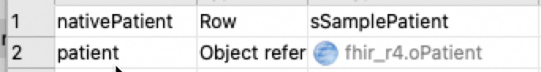
Create Resource
Setup
Add local variable nativePatient (Row, sSamplePatient)
Add local variable patient (Object Reference, fhir_r4.oPatient)
Setup nativePatient data
Do method setupNativePatient (nativePatient)
In the $isvalid() branch
Create Resource by FHIR Typename
Calculate patient as $cinst.$context().$createResource('Patient')

Slide 43
Set Attributes
In the $createPatientOnServer1
Do $cinst.$patientToResource($cinst.$context(),nativePatient.$ref,patient)
In the $patientToResource method
We copy all attributes from the native representation pNativePatient (Item reference) into the FHIR Resource pFHIRPatient (Object Reference)
Since we will have to create new resources we also have pContext (Object Reference)

Slide 44
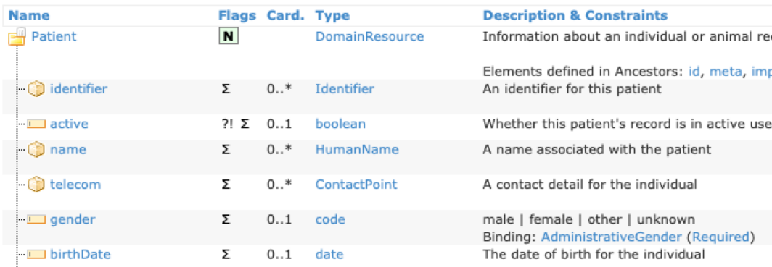
Simple Attributes
Do pContext.$fhirlib() Returns fhirlib # fhirlib being an item reference to the fhir_xxx.lbs in use
# Assignment: id Calculate pFHIRPatient.$id as pNativePatient.sampleID
# Assignment: birth
Calculate pFHIRPatient.$birthDate as pNativePatient.sampleBirth
# Switch matching codes: gender
Switch pNativePatient.sampleSex
Case 'M’
Do code method [fhirlib.$name()].csAdministrativeGender/$male Returns pFHIRPatient.$gender
Case 'F’
Do code method [fhirlib.$name()].csAdministrativeGender/$female Returns pFHIRPatient.$gender
Default
# if we do not know, we do not set
End Switch

Slide 45
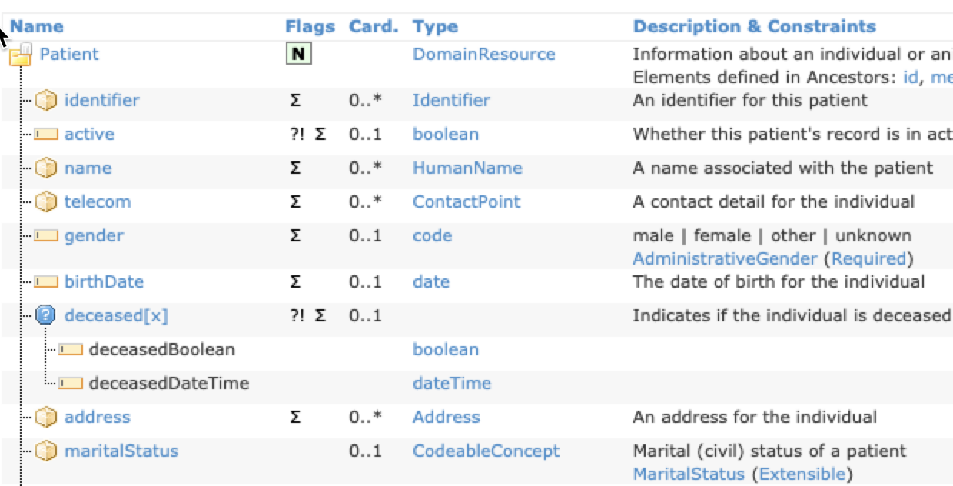
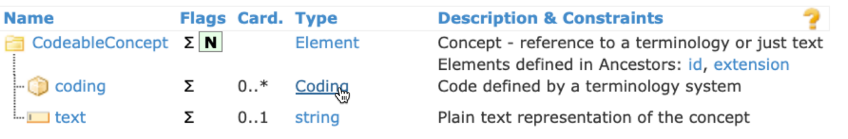
Complex Attributes (Card ..1)
if not set, a new instance gets created automatically upon accessing
Calculate codeableConcept as pFHIRPatient.$maritalStatus
Switch pNativePatient.sampleMaritalStatus
Case 'U’
Calculate codeableConcept.text as "unmarried"
…
Default
# all other cases should be handled as well
End Switch

Slide 46
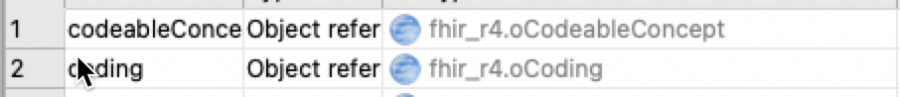
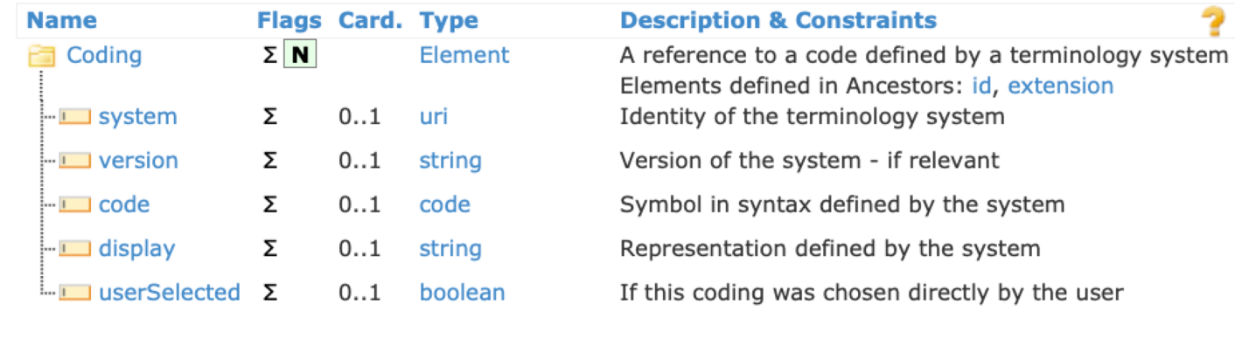
Adding to Collections (Card … >1)
Create Element, then use the add … method
Calculate coding as pContext.$createResource("Coding")
Calculate coding.code as U'
Calculate coding.system as 'http://terminology.hl7.org/CodeSystem/v3-MaritalStatus'
Calculate coding.display as 'unmarried'
Do codeableConcept.$addcoding(coding)
Convenience method
Calculate coding as pContext.$createcoding('http://terminology.hl7.org/CodeSystem/v3-MaritalStatus','U','unmarried')

Slide 47
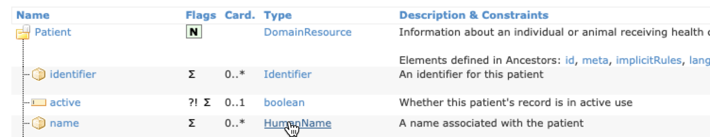
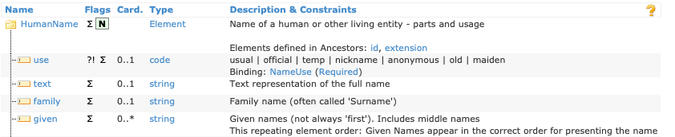
Adding to Collections cont.
Or use the add … method without param → creates new instance
# calling add… to get a new instance (object ref)
Calculate name as pFHIRPatient.$addname()
Calculate name.$use as 'official'
Calculate name.$family as pNativePatient.sampleLastname
For simple types direct add
# direct parameter (especially elegant for primitive types)
Do name.$addgiven(pNativePatient.sampleFirstname)

Slide 48
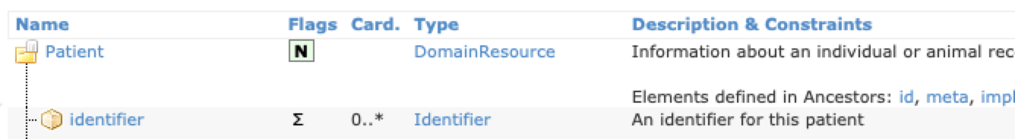
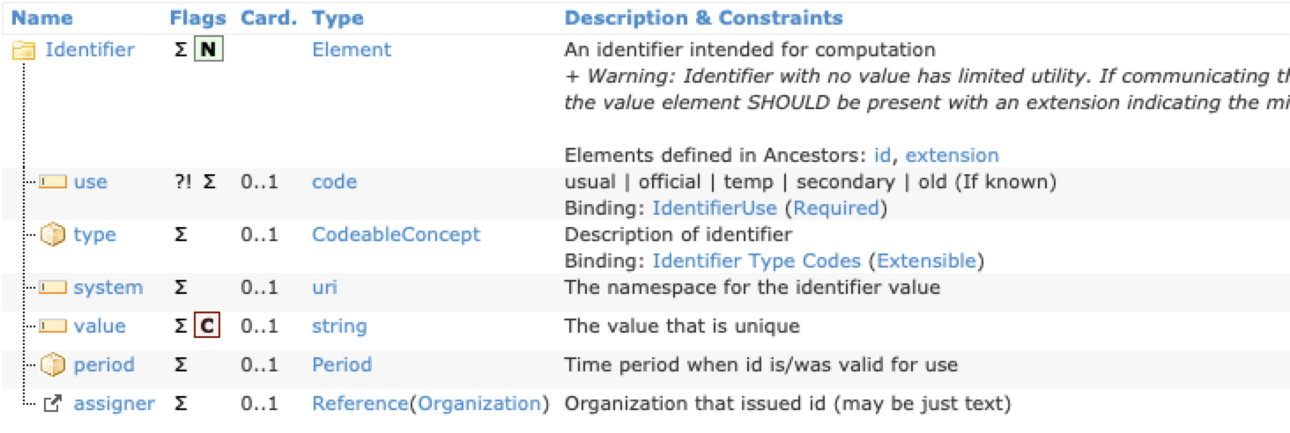
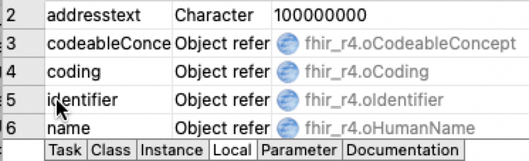
Identifiers (not the id element)
Eg MR (Medical Record Number) is mandatory in many situations
Calculate identifier as pFHIRPatient.$addidentifier()
Calculate identifier.$use as 'usual'
Calculate identifier.$system as "http://www.myomnisfhirsample.org/"
Calculate identifier.$value as pNativePatient.sampleUUID
Calculate codeableConcept as identifier.$::type()
Calculate coding as codeableConcept.$addcoding()
Calculate coding.$system as "http://terminology.hl7.org/CodeSystem/v2-0203"
Calculate coding.$code as "MR"

Slide 49
Profiles
Profiles indicate the «contract» a resource conforms to
Calculate meta as pFHIRPatient.$meta()
Do meta.$addprofile("http://fhir.ch/ig/ch-core/StructureDefinition/ch-core-patient") Do meta.$addprofile("http://fhir.ch/ig/ch-core/StructureDefinition/ch-core-patient-epr")

Slide 50
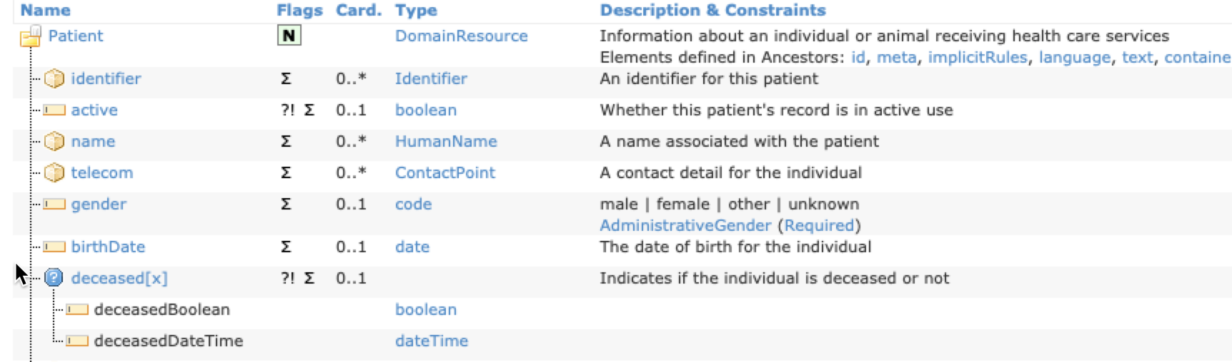
Polymorphic Elements
If pNativePatient.sampleDeathdate<>’’
create either a boolean
Calculate polymorph as pContext.$createSimpleType('boolean’)
Calculate polymorph.$value as pNativePatient.sampleDeathdate<>’’
or a date
Calculate polymorph as pContext.$createSimpleType('dateTime’)
Calculate polymorph.$value as pNativePatient.sampleDeathdate
which is assigned to the element ‘deceased’
Calculate pFHIRPatient.$deceased as polymorph
End If

Slide 51
Extensions
Calculate extension as pFHIRPatient.$addextension()
Calculate address as pContext.$createResource('Address')
Calculate address.city as pNativePatient.samplePlaceOfOriginCity
Calculate address.state as pNativePatient.samplePlaceOfOriginState
Calculate extension.url as 'http://fhir.ch/ig/ch-core/StructureDefinition/ch-core-patient-ech-11-placeoforigin'
Calculate extension.value as address

Slide 52
Dealing with References
Create References
(… practitioner resource setup) Calculate pFHIRPatient.$generalPractitioner as pContext.$createReference(practitioner)
Create Internal References (contained Resource, outside scope of this presentation)
Do docRef.$addcontained(pSubSetAuthor)
Do docRef.$addauthor(pContext.$createInternalReference(pSubSetAuthor))

Slide 53
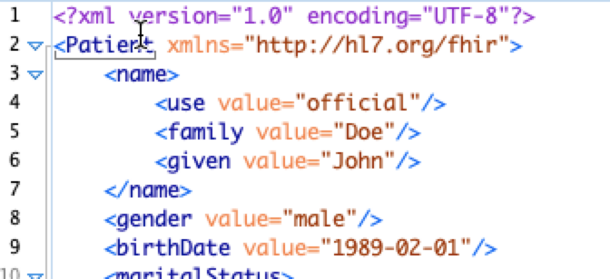
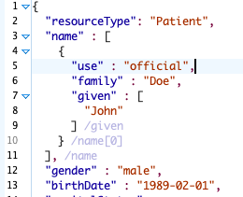
Getting the Data out of a Resource
$asxml/$asjson() returns a text in the respective format
$astext(format) as generic method
Calculate result as patient.$asxml() Calculate result as patient.$asjson()

Slide 54
Communicating with a REST Server
Setup Authentication
Most often oAuth2 (nothing special here)
Setup FHIR Server Base URL
Calculate $cinst.$baseURL as 'http://localhost:8080/fhir’

Slide 55
Pushing Data on a REST Server
Convenience Method
Calculate format as 'json'
Do $cinst.$POSTResource('Patient', patient, format) Returns response
Or even more convenient
Do $cinst.$POSTPatient(patient,format) Returns response
If left(response.$statusCode(),1)='2’
OK message Success {Resource Createds Call returned [response.$statusCode()]}
Else
OK message Error {HTTP Call returned [response.$statusText()] ([response.$statusCode()])}
End If

Slide 56
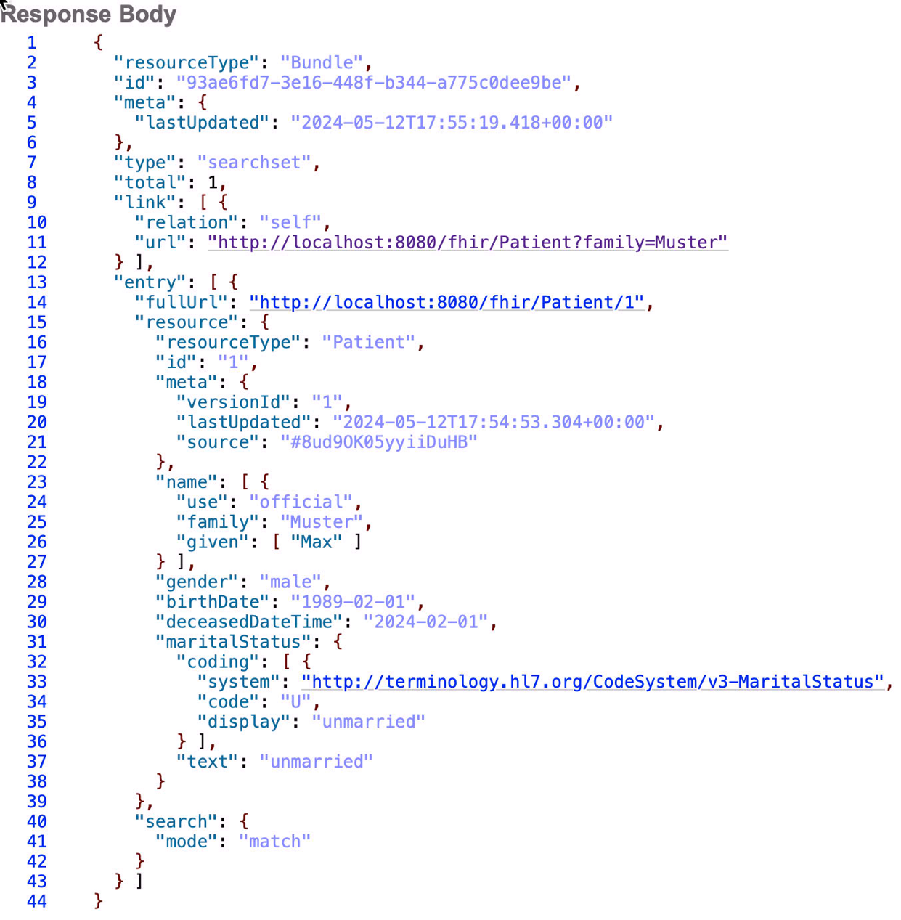
http://localhost:8080/fhir/Patient?family=Muster

Slide 57
Querying a REST Server
Convenience Method
Do $cinst.$GETResource('Patient?family=Muster',format) Returns response
If left(response.$statusCode(),1)='2’
Calculate content as utf8tochar(response.$content())
Calculate bundle as $cinst.$context().$createFromText(content,format)
OK message Success {Search Query returned [bundle.$total] Elements}
Else
OK message Error {HTTP Call returned [response.$statusText()] ([response.$statusCode()])}
End If

Slide 58
Maybe some Refactoring…

Slide 59
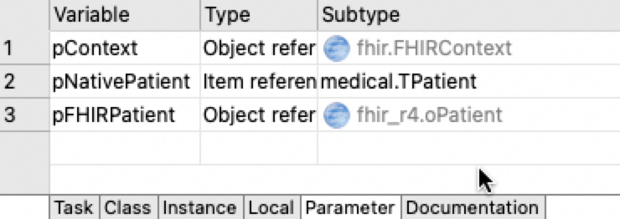
Translation
Ingredient: Subclassed oFHIRBridge
Move methods to your subclass
$patientToResource(pContextRef, pNativeResourceRef, pFHIRResourceRef)
This is called eg from oFHIRClientEndpoint‘s $createPatientResourceFromNative

Slide 60
POST for creation
Do $cinst.$createPatientResourceFromNative(iCurrentPat.$ref) Returns patientResource
…
Do $cinst.$POSTResource('Patient’,patientResource,format) Returns response

Slide 61
Setting up Resources
Ingredient: Subclassed oFHIRBridge (Translating between „native“ and „FHIR“ Representation, see next slides)
Subclass oFHIRClientEndpoint
Call Translation
Do iBridge.$patientToResource(iContext,pNativePatient.$ref,patient)

Slide 62
Q & A

